Slide 1
IBM data science project presentation the battle of neighborhoods (capstone project)
Presented by : Rishi Ranjan
Techno Engineering college Banipur

Slide 2
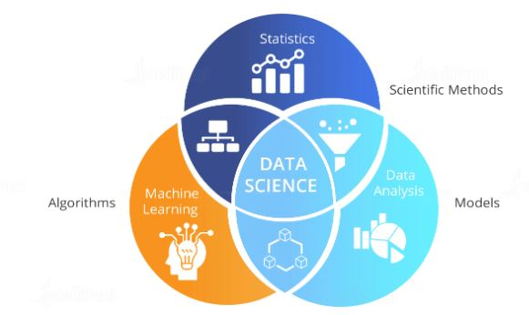
What is Data Science ?
Data science is the art of uncovering the insights and trends that are hiding behind data. It's when you translate data into a story. So use storytelling to generate insight. And with these insights, you can make strategic choices for a company or an institution.

Slide 3

Open Source tools for Data Science
In this course, I have learned about various open source tools for Data Science.
Skill Network Labs
Jupyter Notebooks
Apache Zeppelin Notebooks
Rstudio IDE
IBM Watson studio

Slide 4
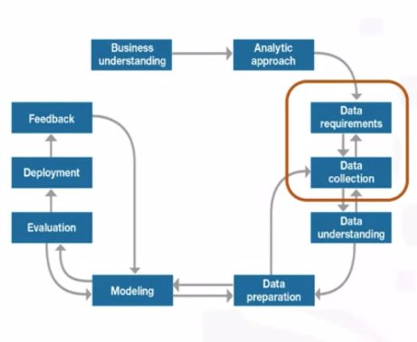
Data Science Methodology
In this course I have learned about the major steps involved in tackling a data science problem. - The major steps involved in practicing data science, from forming a concrete business or research problem, to collecting and analyzing data, to building a model, and understanding the feedback after model deployment. - How data scientists think!.

Slide 5

Python for Data Science and AI
In this course I have learned about Python Basics like types, expressions, variables, string operations, lists, tuples, sets, dictionaries, Loops, objects and classes, file handling, pandas and numpy.

Slide 6

Databases and SQL for Data Science
I have learned about relational database concepts that helps to apply foundational knowledge of the SQL language, performing SQL access in a data science environment. The emphasis in this course is on hands-on and practical learning. I have also created some database instances in the cloud. I have done series of hands-on labs, practice building and running SQL queries in this lab. I have also learned how we can access databases from Jupyter notebooks using SQL and Python

Slide 7
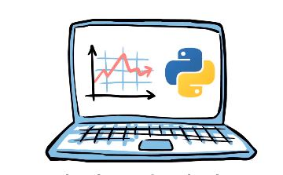
Data Analysis with Python
In this course I have learned about Importing Datasets, Cleaning the Data , Data frame manipulation, Summarizing the Data. It includes following parts: Data Analysis libraries, use of Pandas, Numpy and Scipy libraries to work with a sample dataset. I have used this library to load, manipulate, analyze, and visualize cool datasets.

Slide 8
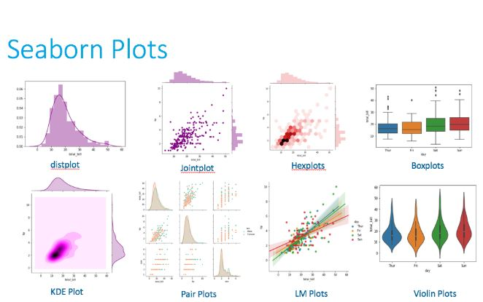
Data visualization with Python
This course was all about several data visualization libraries in Python like Matplotlib, Seaborn, and Folium and how we can tell a compelling story by visualizing the data and findings from the data

Slide 9

Machine Learning with Python
In this course I have learned about some of machine learning topics like supervised and unsupervised learning, classification, clustering and some Python libraries like Sci-kit learn and Scipy.

Slide 10
Applied Data Science Capstone
In this course I have learned about FourSquare API ( It is a restful API to retrieve the data about venues in different neighborhoods around the world and I have applied this learning to complete my Capstone Project.

Slide 11
Introduction
A digitally native vertical fashion retailer, with a substantial e-commerce footprint, has begun the rollout of brick and mortar stores as part of their omnichannel retail strategy. After rolling out stores in a few select cities by guessing where the best locations were to open, as part of their store expansion for Paris they've decided to be more informed and selective, and take the time to do some research.
I've been given the exciting task of assisting them to make data-driven decisions on the new locations that are most suitable for their new stores in Paris. This will be a major part of their decision-making process, the other being on the ground qualitative analysis of districts once this data and report are reviewed and studied.
The fashion brand is not what is considered high-end, they are positioned in upper end of the fast fashion market. As such, they do not seek stores in the premium up market strips like Avenue Montaigne, but rather, in high traffic areas where consumers go for shopping, restaurants and entertainment. Foursquare data will be very helpful in making data-driven decisions about the best of those areas.

Slide 12
Data to be used
. Data source:https://data.opendatasoft.com/explore/dataset
/arrondissements%40parisdata/export/
Description - his data set contains the required information. And we will use this data set to explore various neighborhoods of Paris city.
Data source : Foursquare API
Description : By using this API we will get all the venues in each neighborhood. We can filter these venues to get only New Store Locations in Paris for a Fashion Retailer
Data source : https://opendata.paris.fr/explore/dataset
/arrondissements/table/?dataChart
Description : By using this geo space data we will get the New York Borough boundaries that will help us to visualize choropleth map.

Slide 13
Approach
Collect the New York city data from https://en.wikipedia.org/wiki/Arrondissements_of_Paris
Using FourSquare API we will find all venues for each neighborhood.
Filter out all venues that are suitable new store locations in Paris for a Fashion Retailer.
Find rating , tips and like count for each new store locations using FourSquare API.
Using rating for each locations , we will sort that data.

Slide 14
Libraries to be used
pandas and numpy for handling data.
request module for using FourSquare API.
geopy to get co-ordinates of City of Paris.
Notes:
request module for using FourSquare API.

Slide 15
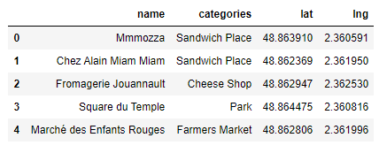
Loading the data and getting the longitude and latitude Step:1
Load data from https://data.opendatasoft.com/explore/dataset/arrondissements%40parisdata/export/ in pandas Dataframe.
Getting Latitude and Longitude for each address geopy library

Slide 16
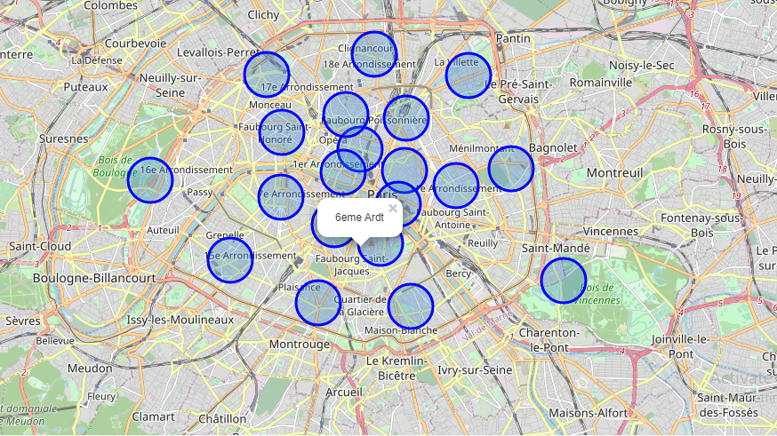
Create a map of Paris with districts superimposed
Step:2

Slide 17
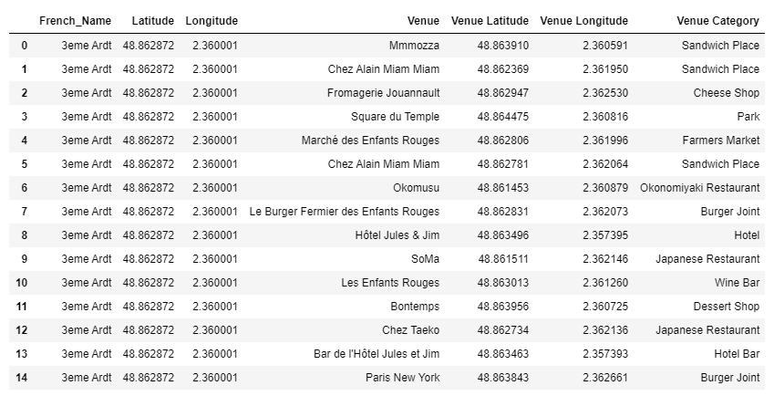
Create a new data frame called for the venues of Paris called paris-venues
Step :3

Slide 18
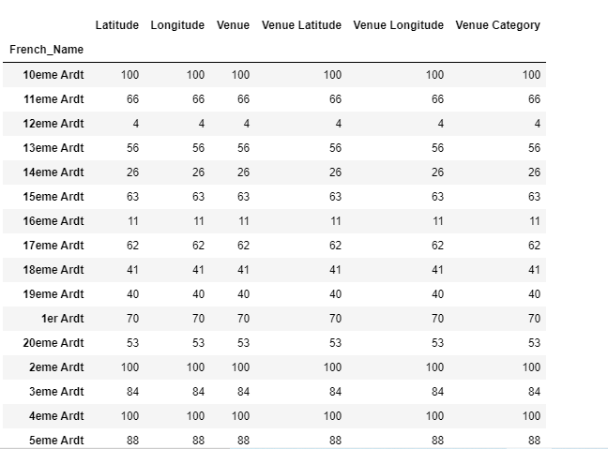
Check how many venues were returned for each neighborhood
Step : 4

Slide 19
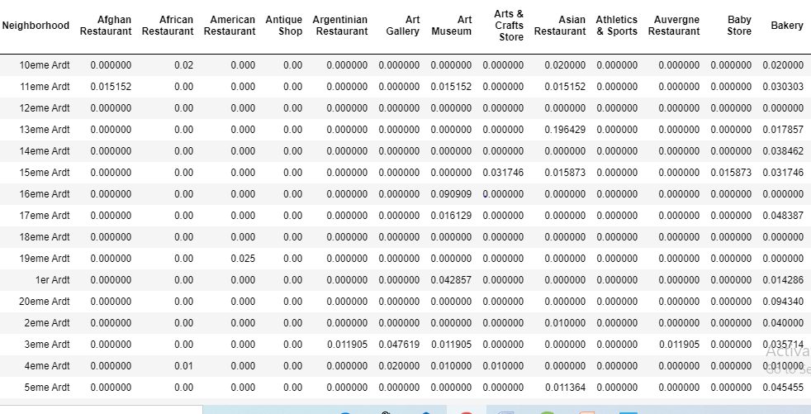
Group rows by neighborhood and take the mean of the frequency of occurrence of each category
Step : 5

Slide 20
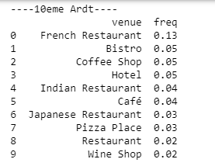
Finding each neighborhood with it's top 10 most common venues
Step : 6

Slide 21
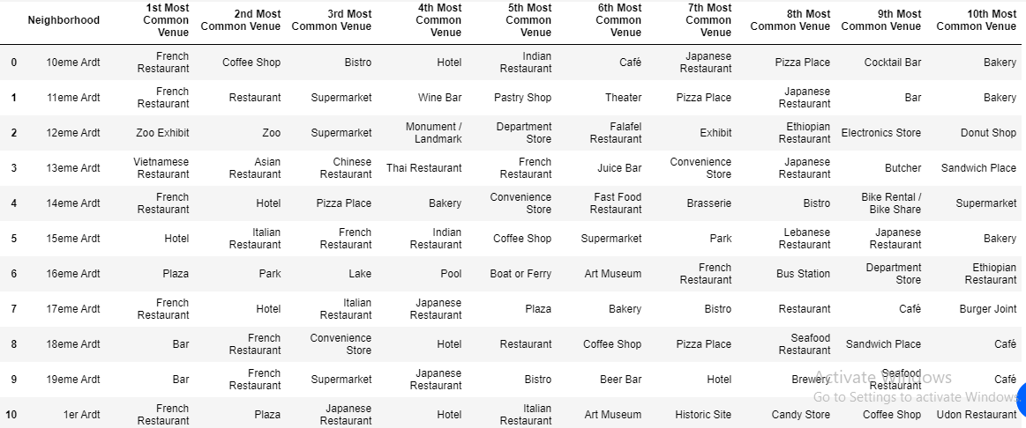
The top 10 venue categories for each neighborhood
Step : 7

Slide 22
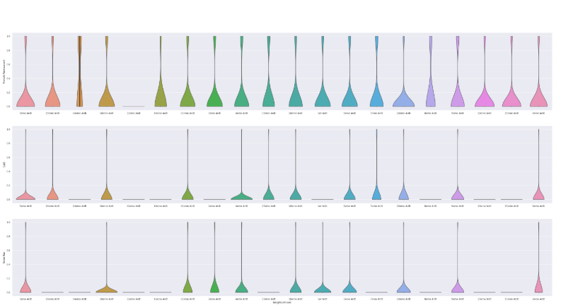
Frequency distribution of top 3 venue categories for each neighbourhood using violinplot
Step : 8

Slide 23
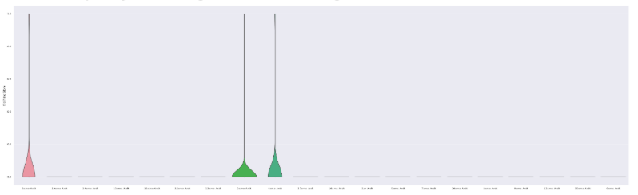
Frequency of clothing stores for each neighbourhood
Step : 9

Slide 24
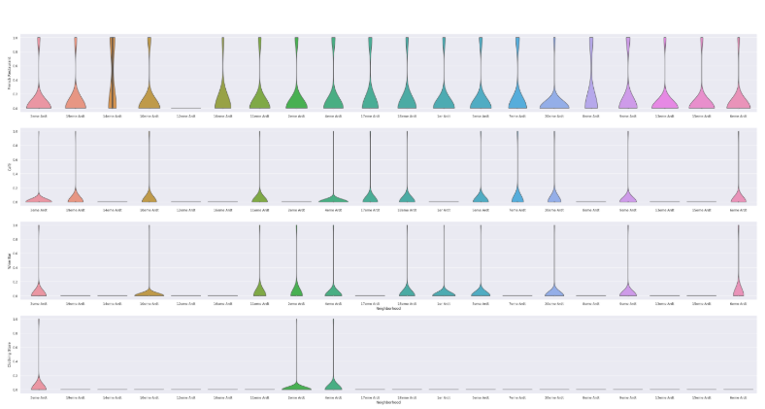
Frequency distribution of top 3 venue categories for each neighbourhood (include clothings)
Step : 10

Slide 25
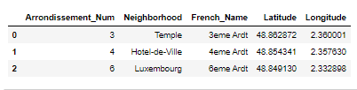
Chosen Neighborhoods - Results
Step : 11
The reasoning being that if the 3 criteria have been met - identifying neighborhoods that are lively with Restaurants, Cafés and Wine Bars - adding Clothing Stores into the mix of stores in the area is a significant bonus. Having some of the same category of stores in the same area - especially in fashion retail - is very desirable as a retailer
So we can increase the criteria to include Restaurants, Cafés, Wine Bars and Clothing Stores - which narrows down and focuses the suggested districts for new stores to be located, and at the same time provides better locations for the brand.
- 3eme Ardt : Arrondissement 3, Temple
- 4eme Ardt : Arrondissement 4, Hotel-de-Ville
- 6eme Ardt : Arrondissement 6, Luxembourg

Slide 26
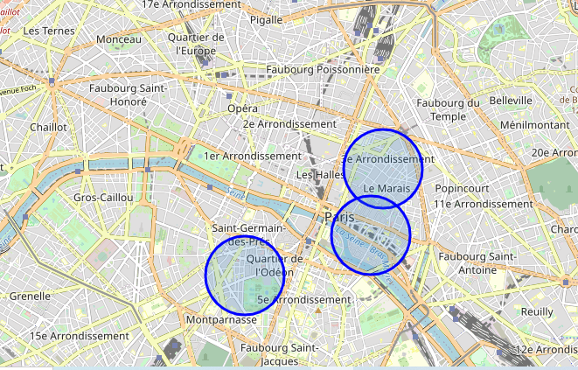
Visualize result on a map of Paris
Step : 12

Slide 27
conclusion
From this visualization it is clear that on a practical level, with no data to base decisions on, the circle of the 20 districts is very large, and researching and then visiting them all would be a daunting and time consuming task. We have narrowed the search area down significantly from 20 potential districts to 3 that should suit the client's retail business.

Slide 28
Thank you

